Slide 1
churn Analysis credit card churn analysis

Slide 2

INTRODUCTION
My stakeholders are directors, investors and bank manager and employees who dealing with customers retention policies.
My manager was very upset from last few months because most of the people leaving their credit card services.
I would analyze the 10,000 customers of that particular bank of last 12 months. I do this analysis to find out the main reason of churn and try to suggest some recommendations which will helpful in making future policies of customers retention.

Slide 3

Problem statement
16% churn rate
Customers Retention is one of the biggest concern of companies to sustain their business and profits in the market and reduce their time and cost for Obtaining new customers.

Slide 4
Project analysis slide 3
Business Problems
What is maximum credit limit at each income level.
What is education level and marital status of churn females.
How many dependent counts they have.
How many females remain inactive in las 12 months
Financial Information
Basic
Information
Demographics
Churn Reasons
What is the income category of churn customers.
What is the card category of churn customers.
Which card category have more churn.
What is the income and card category of churn females.
How many dependent counts they have.
What is the average utilization of churn females.
Total gender count.
Total number of churn gender wise.
What is the marital status of customers.
What is the education level of customers.
Total number of customers.
Total number of Churn and retain customers.
Churn rate.

Slide 5
Project analysis slide 2
DATA ANALYSIS
PROCESS
Insights and recommendations
Understand Data
Analysis
process
Visualization
Define problems and objectives
Analyzing
Cleaning & Processing

Slide 6
Data Overview
Gender ratio
Income category
Card category
Female 53%
Male 47%
Less than $40K 3561
$40K - $60K 1790
$60K - $80K 1402
$80K - $120K 1537
Unknown 1112
$120K + 727
Blue 9436
Silver 555
Gold 116
Platinum 20

Slide 7
DATA
ANALYSIS AND
VISUALIZATION

Slide 8
Gender and
Churn Rate
9%
Female churn ratio is much higher than males i.e. 9% of female and 7% of males tend to leave the credit card .

Slide 9
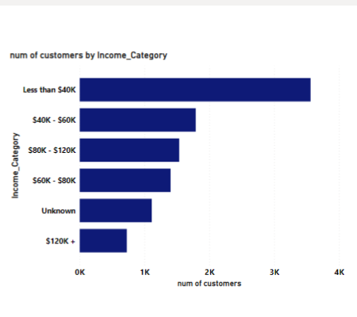
Total churn on each income level
Those customers whose income level is Less than $40k tend to leave the credit card more.

Slide 10
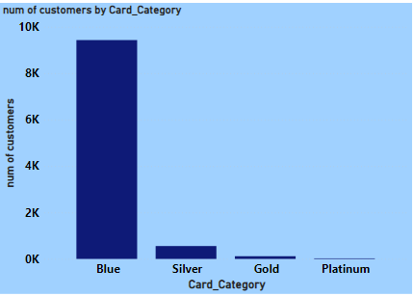
Card category and churn rate
Mostly customers who tend to leave have Blue credit card.

Slide 11

A Large number of customers belongs to Less than $40k income group and have blue credit card and Ratio of female is high.
So for father analysis we have split data into female and income category because of getting churn reason.

Slide 12
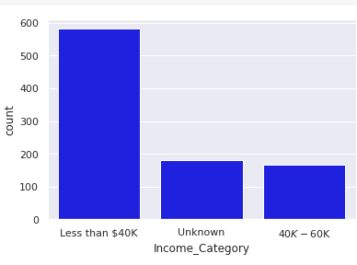
Churn female and income level
Female who tend to leave more is belongs to Less than $40k income level.

Slide 13
churn female and card category
Card Category | No. of Customers
Blue | 890
Silver | 28
Gold | 8
Platinum | 4
Most of the female customers who wanted to leave the credit card having Blue credit card.

Slide 14
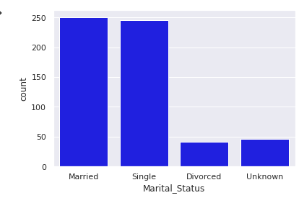
Marital status and churn
Most of the females who churned was married, some was single and little bit was divorced.

Slide 15
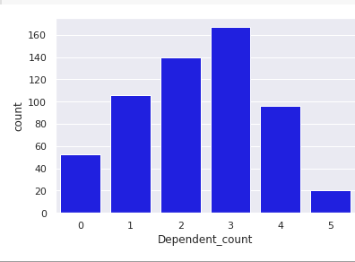
Dependent counts and churn
Females who tend to leave the card facility have mostly 3 dependent counts.

Slide 16
Average utilization ratio and credit limit most of the churn customers belongs to less than $40k income group and have much low credit limit and utilization ratio.
Income Category | Credit Limit | Avg-utilization-ratio
Less than $40k | 15987 | 10%
$40k - $60k | 23981 | 11%
$60k – $80k | 0 | 0
$80k - $120k | 0 | 0
$120k + | 0 | 0
Unknown | 34516 | 10%

Slide 17
Inactivity and churn those customers who tend to leave the card remain 3 months in active .its mean those whose active all the time are retain customers.
Inactive months | No. of customers
3 | 299
2 | 187
4 | 35
1 | 34
5 | 11
6 | 9
0 | 7

Slide 18
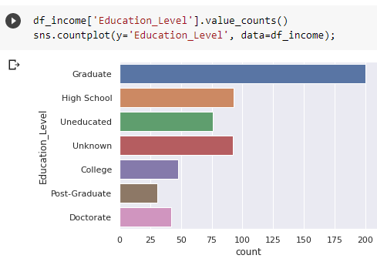
Educational level and churn
Those female who tend to leave are mostly graduates and having job.
Some are from high school.

Slide 19
Male customers and churn
When I want to analyze male churned customers I would like to split data into male and get following insights:
mostly male customers are also belongs to less then $40k income group.
they having blue card.
They are married and MOSTLY ARE GRADUATES.

Slide 20
Project analysis slide 6
INSIGHTS & CONCLUSION
We clearly see that mostly female leave having BLUE credit card .
CHURN FEMALE mostly belong to less than $40k income group.
Mostly female are married and mostly have 3 dependents counts, some are single and little bit are divorced.
They mostly are graduates its means these female are job holders and have dependents and home expense as well. So its been difficult for them to payback .
Mostly churned customers remain 3 months inactive.
Their credit limit and average utilization ratio is low.

Slide 21
recommendations
The bank should provide attractive credit limit and easy payback packages to the blue and silver card holders, so that their purchasing power may increases and in this way they can retain customers of low income groups.
The bank should add different offers regarding shopping, food etc in benefits of credit card to attract more females and to remain them active.
Mostly females have dependent counts so the bank should provide them easily billing policies so that they make transaction of billing and schooling from credit card very conveniently and get information about their transactions without any fee.
They bank should provide some benefits of gold and platinum card to the blue and silver card customers because majority of customers have these two cards
The bank should provide more rewards to the customers such as cash back or miles points .
The bank should provide more credit score options for card holders because a good credit score can help them in better interest rates for things like cars, loans, houses and property etc.

Slide 22
Thank You
Presented by:
Farah Ejaz Farrahnaveed0@gmail.com

